Slide 1
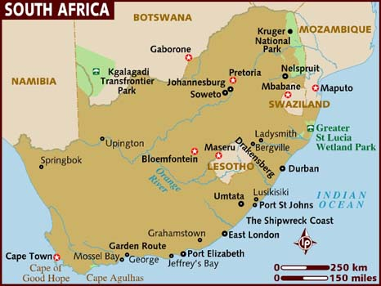

Slide 2
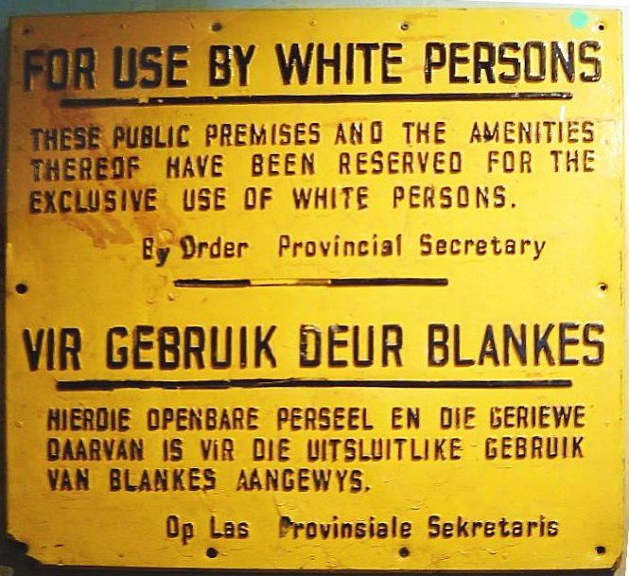
Apartheid

Slide 3
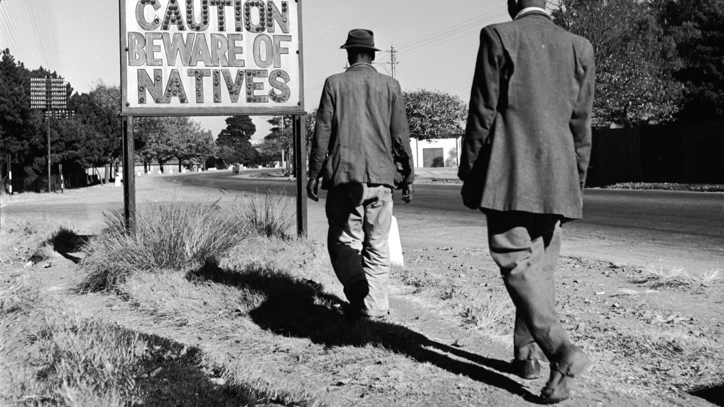

Slide 4
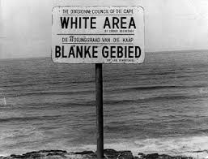

Slide 5
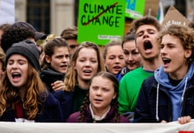
Climate Change

Slide 6
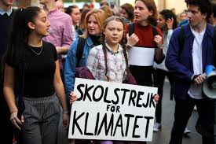

Slide 7
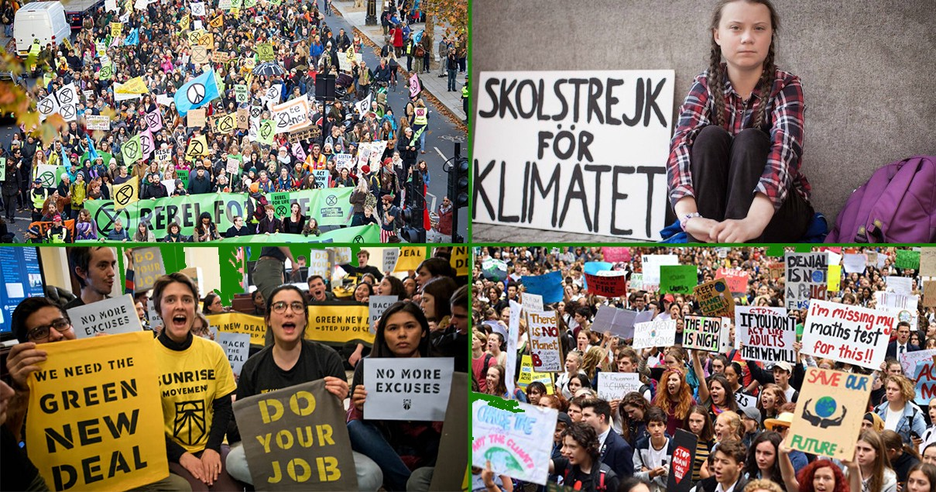

Slide 8
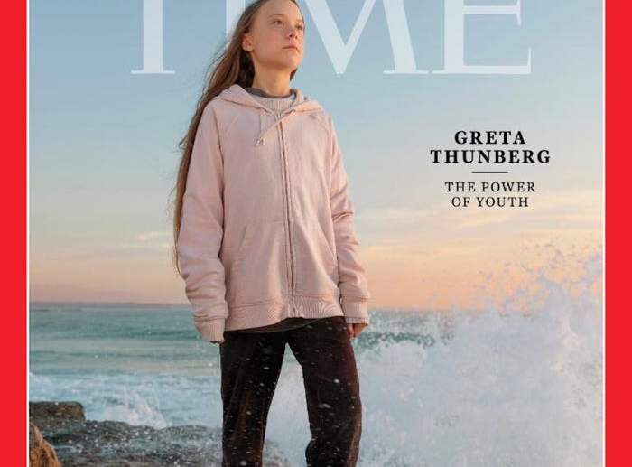

Slide 9
Pre-reading
The article can be divided into two distinct parts. What are they?
What textual/tense references indicate these parts?
Who is the article about?

Slide 10
Apartheid
Apartheid officially became a way of life in South Africa in 1948, when the Afrikaner National Party came into power after heavily promoting the racially stratified system. In Afrikaans, "apartheid" means “apartness” or “separateness.” More than 300 laws led to apartheid's establishment in South Africa.

Slide 11
Apartheid
Under apartheid, South Africans were categorized into four racial groups: Bantu (South African natives), colored (mixed-race), white and Asian (immigrants from the Indian sub-continent.) All South Africans over the age of 16 were required to carry racial identification cards. Members of the same family often were categorized as different racial groups under the apartheid system. Apartheid not only banned interracial marriage but also sexual relations between members of different racial groups.

Slide 12
The Soweto Uprising
The Soweto uprising was a series of demonstrations and protests led by black school children in South Africa that began on the morning of 16 June 1976. ... It is estimated that 20,000 students took part in the protests. They were met with fierce police brutality.
The introduction of Afrikaans alongside English as a medium of instruction is considered the immediate cause of the Soweto uprising, but there are a various factors behind the 1976 student unrest.
Although the protests of 16 June 1976 resulted in a number of casualties, the youth of 1976 played a role in fighting and overcoming the inequality and oppression caused by apartheid. Today, 16 June is a South African public holiday.

Slide 13
The 1952 Defiance Campaign
The Defiance Campaign was launched on the anniversary of the National Day of Protest, 26 June 1952. The South African police were alerted about the action and were armed and prepared. In major South African cities, people and organizations performed acts of defiance and civil disobedience.
Although the campaign did not achieve the desired aim of overturning the apartheid laws, it was successful in a number of other respects. The resistance won United Nations recognition that the South African racial policy was an international issue and a UN Commission was established to investigate the situation.

Slide 14
The 1952 Defiance Campaign
All Government action and response was decided according to the policy of apartheid. ... This Campaign brought Africans, Coloureds and Indians together against the common enemy and was a direct reaction by the liberation movements to the unjust laws passed by the government.

Slide 15
Greta Thunberg
Greta Thunberg "has succeeded in creating a global attitudinal shift, transforming millions of vague, middle-of-the-night anxieties into a worldwide movement calling for urgent change," the editors of Time wrote in December, when they named her the magazine's 2019 person of the year.
Thunberg launched the "Fridays For Future" movement — or School Strike for Climate (as it says in Swedish on her now-famous sign) — in 2018, encouraging students to skip school to demand action on climate change from their governments. That November, when she was in ninth grade, Thunberg staged a two-week strike outside the Swedish parliament, demanding that her government cut emissions by 15% a year.

